Slide 1


DEPARTMENT OF AUTOMOBILE ENGINEERING
MIT CAMPUS, ANNA UNIVERSITY, CHENNAI – 44
FINAL REVIEW
S.No | Name | Register Number
1 | NIROSHINI. K | 2019502032
2 | AKILAN. S | 2019502509
3 | DHINESH BABU. R | 2019502517
4 | HARI VIGNESH. N S | 2019502523
GUIDE:
Mr. P.Elayaraja
Teaching Fellow,
Department of Automobile Engineering,
MIT campus, Anna university

Slide 2
TITLE
EXPERIMENTAL ANALYSIS OF PERFORMANCE,COMBUSTION AND EMISSION CHARACTERISTICS OF SINGLE CYLINDER DIESEL ENGINE USING BIODIESEL (DIESEL-TURPENTINE BLEND) WITH HYDROGEN INDUCTION.

Slide 3
INTRODUCTION
Entire worldwide, fossil reserves are getting scantier and progressively exorbitant with time.
Moreover, constant dependency on them leads to the frightening plight of global warming. Higher fuel prices and limited natural resources have forced the researchers to pursue research on green alternative fuels.
The use of biodiesel obtained from plants in internal combustion engine is finding its place to replace the use of conventional fuel. In our research, the performance, combustion and emission characteristics of diesel engine fueled with biodiesel (diesel-turpentine blend) with hydrogen induction.

Slide 4
LITERATURE SURVEY
SI NO | JOURNAL NAME | YEAR | TOPIC | AUTHORS | INFERENCE
1 | Elsevier | 2019 | Experimental study on the effect of cetane improver with turpentine oil on CI engine characteristics | A.K.Jeevanantham, D.Madhusudan reddy,B.Ashok, Aman kumar | A novel cetane improver called SC5D is added with 20% blend of turpentine with diesel. For higher Nox emission condition,10% of EGR is applied. At this condition, unburned HC and smoke emissions are remarkably lower.
2 | Researchgate | 2017 | A review on novel bio-fuel from turpentine oil | Mehmet Hakki Alma, Tufan Salan | At 40% blend of turpentine oil with diesel mixture shows 2.5% increase in BTE than the diesel. nearly 50% smoke was reduced but a little shoot and co was found.

Slide 5
SI NO | JOURNAL NAME | YEAR | TOPIC | AUTHORS | INFERENCE
3 | Elsevier | 2018 | Influences of dual bio-fuel (Jatropha biodiesel and turpentine oil) on single cylinder variable compression ratio diesel engine | Pankaj Dubey, Rajesh Gupta | Experiments have been accompanied at CR of 15.5:1,17:1,18.5:1 and 20:1. Biofuel blend (JBT50) resulted at full load and CR 20:1,there was 2.17% increase inBTEand13.04%,17.5%,4.21% and 30.8% decrease in CO,HC, NOx and smoke and 11.04% increase in CO respectively.
24 | Elsevier | 2010 | Performance and exhaust emission of turpentine oil powered direct injection diesel engine | B. Prem Anand, C.G. Saravanan, C. Ananda Srinivasan | 30% of turpentine oil blend with diesel produce high brake power and net heat release rate with a net reduction in CO,HC,Nox,smoke and particulate matter. 40% and 50% blends produce lower brake power.

Slide 6
RESEARCH GAP
A review on novel bio-fuel from turpentine oil by Mehmet Hakki Alma, Tufan Salan (2017) - has discussed about the use of 40% of turpentine oil blend with diesel in diesel engine.
Influences of dual bio-fuel (Jatropha biodiesel and turpentine oil) on single cylinder variable compression ratio diesel engine by Pankaj Dubey, Rajesh Gupta (2018) – has discussed about the use of jatropha and turpentine oil blend in single cylinder diesel engine.
But so far no one has explored the arena of using hydrogen induction with turpentine blend with diesel biodiesel and analyzing the performance, combustion and emission characteristics of single cylinder ci engine.

Slide 7
AIM & OBJECTIVE
To experimentally test the performance , combustion , emissions characteristics of single cylinder diesel engine using biodiesel.
Objective is to compare the characteristics of biodiesel blends(diesel-turpentine) and the same with hydrogen induction.

Slide 8
METHODLOGY
Literature survey
Problem identification
Preparation of biodiesel blend
Measuring the properties of the sample biodiesel blend
Testing of the sample biodiesel in CI engine
Comparison of characteristics(biodiesel blends vs diesel)

Slide 9
METHODLOGY
Installation of experimantal setup for hydrogen induction
Testing of the sample biodiesel blend with hydrogen induction
Calculation of the characteristics obtained from the result
Comparison of characteristics (biodiesel blend vs diesel)
submission of final report

Slide 10
WHY TURPENTINE OIL?
Turpentine oil is physically a yellowish, opaque, odorous and water-immiscible liquid when it is chemically flammable,volatile and combustible.
Turpentine oil is mixture of α- and β- pinenes(30% and 60% respectively) and other isometric terpenes.
Turpentine oil is extracted from the resin of pine tree(genus pinus) saps and leaves.
Turpentine oil having low viscosity and lower carbon resides and environmentally friendly due to its low Sulphur content Also, the properties of turpentine oil are similar with diesel.

Slide 11
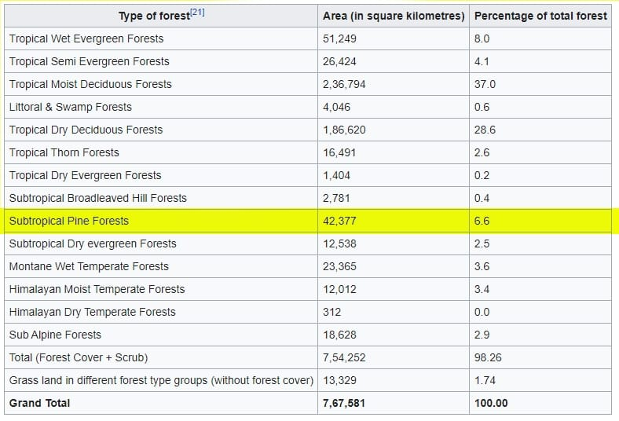
PINE TREE GROWTH IN INDIA

Slide 12
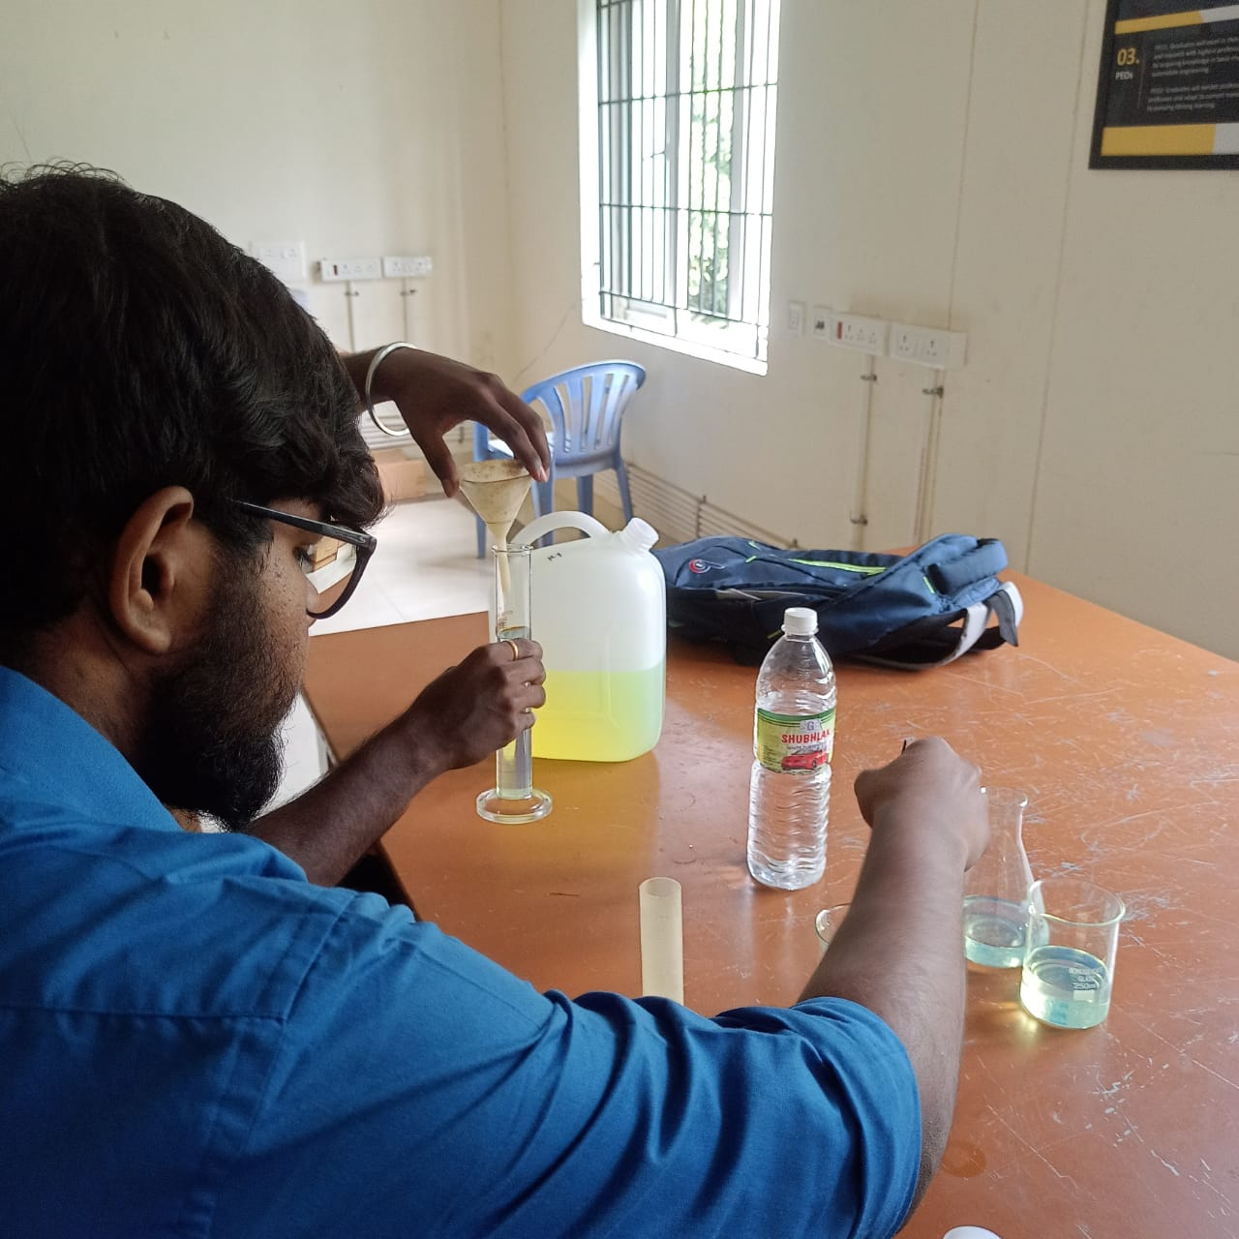
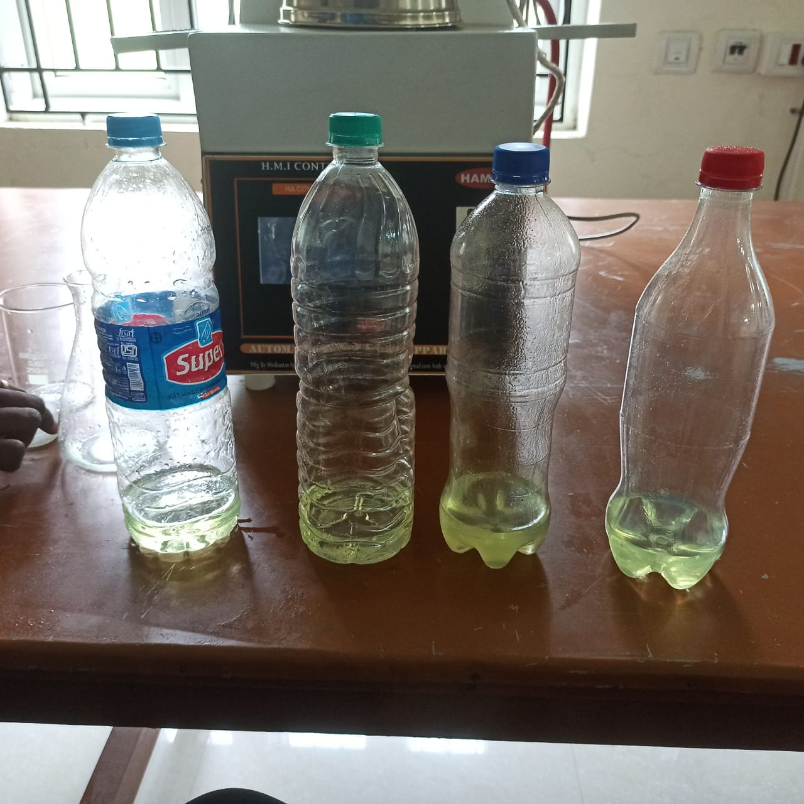
PREPARATION OF BIODIESEL(DIESEL-TURPENTINE BLEND)
4 BLENDS:
B20 (20%TURPENTINE 80%DIESEL)
B30 (30%TURPENTINE 70%DIESEL)
B40 (40%TURPENTINE 60%DIESEL)
B50 (50%TURPENTINE 50%DIESEL)

Slide 13
PROPERTIES
Properties of Turpentine biodiesel which are close to Diesel:
DENSITY:
The density of material shows the denseness of that material in a specific given area. A material’s density is defined as its mass per unit volume.
Density is essentially a measurement of how tightly matter is packed together. It is a unique physical property for a particular object
The formula used to calculate the density is,
DENSITY = MASS/VOLUME
Unit = kg/m³

Slide 15
FLASH AND FIRE POINT:
The flash point is the lowest temperature at which a volatile substance evaporates to form an ignitable mixture with air in the presence of an igneous source and continues burning after the trigger source is removed.
Flash point is a significant property not for the operability of a diesel fuel, but for its storage and handling.
The fire point is defined as the lowest temperature at which vapors of the material will catch fire and continue burning even after the ignition source is removed. The fire point is higher than the flash point because the vapors produced at the flash point are not sufficient enough to ignite the fuel.

Slide 17
KINEMATIC VISCOSITY:
The kinematic viscosity is an important fuel property which affects the atomization of a fuel upon injection into the combustion chamber.
REDWOOD VISCOMETER is used to measure the kinematic viscosity.
Hence, as the viscosity is less, the fuel is atomized properly, resulting in a complete combustion and good engine performance.
The formula to calculate the kinematic viscosity is,
Kinematic viscosity = AR – B/R (m²/s)
where,
A & B are viscometer constants A = 0.26 ,B = 171.5
R = time in second for collection of 60 cc of oil in the flask.

Slide 19
PROPERTIES OF FUEL
BLEND | DENSITY(kg/m³) | KINEMATIC VISCOSITY ( m²/s) | FLASH POINT (°c) | FIRE POINT (°c)
DIESEL | 0.827 | 13.28 | 47 | 54
B20 | 0.831 | 14.567 | 49 | 55
B30 | 0.835 | 14.147 | 52 | 57
B40 | 0.839 | 13.360 | 55 | 60
B50 | 0.844 | 13.055 | 57 | 62
TURPENTINE | 0.845 | 10.870 | 53 | 58

Slide 20
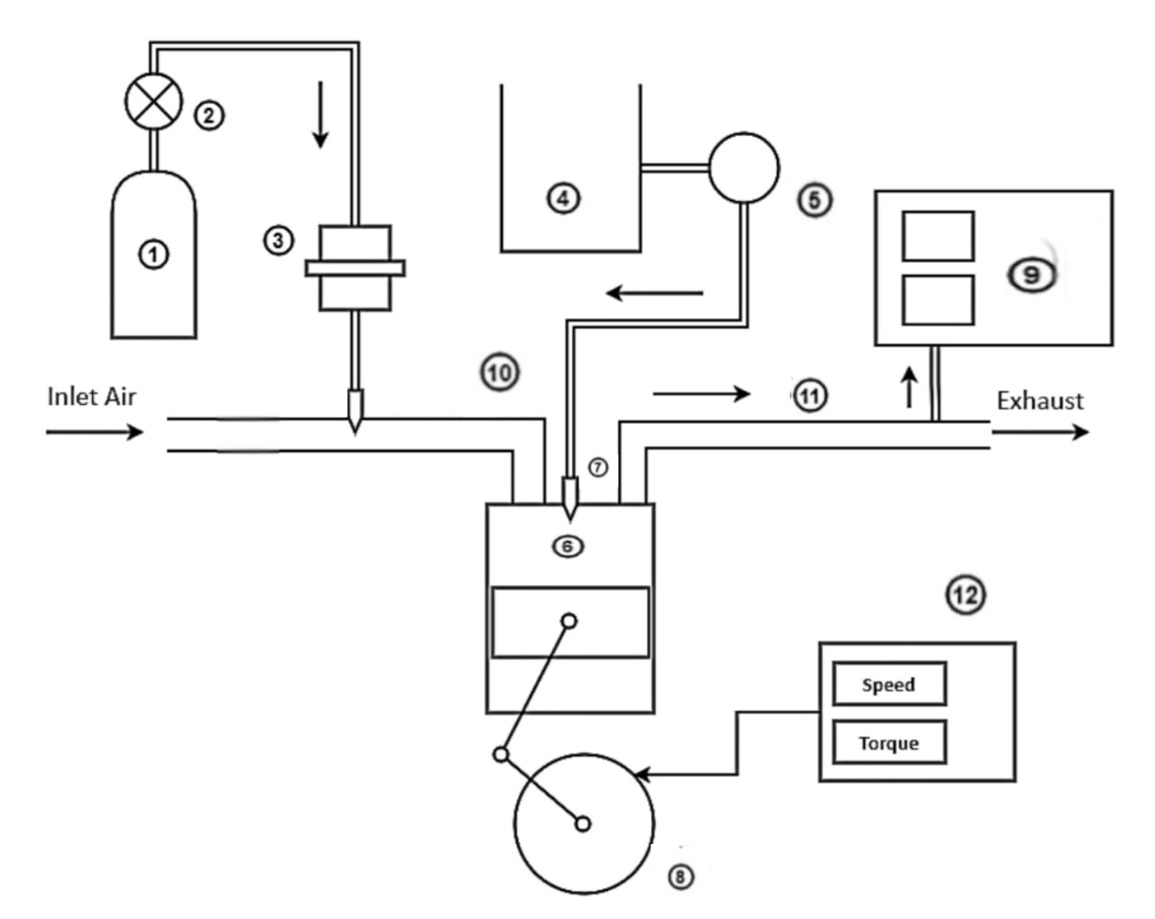
ENGINE LAYOUT
① - Hydrogen Storage Tank
② - Pressure Regulator
③ - Flame Arrestor
④ - biodiesel-Diesel blend tank
⑤ - Fuel Pump
⑥ - Diesel Engine
⑦ - Fuel Injector
⑧ - Crank Wheel
⑨ - Exhaust Gas Analyzer
⑩ - Inlet Manifold
⑪ - Exhaust Manifold
⑫ - Dynamometer

Slide 21
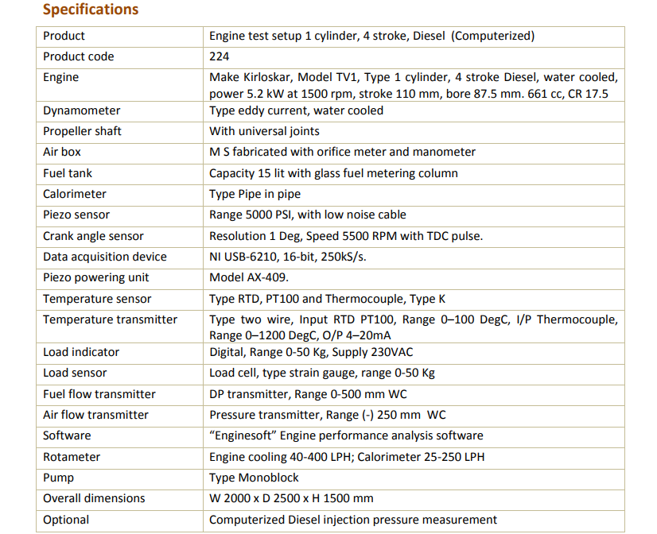
ENGINE SPECIFICATIONS

Slide 22
ENGINE DESCRIPTION and SOFTWARE USED
The setup consists of single cylinder four stroke diesel engine connected to the eddy current type dynamometer for loading.
Its provided with necessary instruments for combustion pressure and crank angle measurements.
EngineSoft is LabView based software package developed by APEX INNOVATIONS Pvt. Ltd for engine performance monitoring system.
It evaluates power efficiencies,fuel consumption and heat release.
It is configurable as per engine setup.
Various graphs are obtained at different operating conditions.

Slide 23
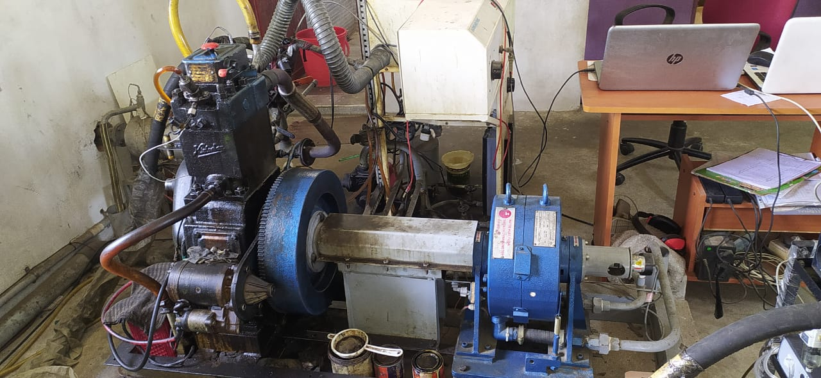

Slide 24
PERFORMANCE GRAPHS

Slide 25
BRAKE THERMAL EFFICIENCY

Slide 26
SPECIFIC FUEL CONSUMPTION

Slide 27
BTE VS BP

Slide 28
COMBUSTION GRAPHS

Slide 29
CRANK ANGLE VS HEAT RELEASE RATE

Slide 30
EMISSION GRAPHS

Slide 32
SMOKE

Slide 33
EMISSION DATA

Slide 34
PERFORMANCE CHARACTERISTICS

Slide 35
COMBUSTION CHARACTRISTICS

Slide 36
EMISSION CHARACTERISTICS

Slide 37
WORK TO BE DONE
Testing of biodiesel in ci engine
Comparison of characteristics of diesel with biodiesel
Experimental setup for hydrogen induction in single cylinder diesel engine.
Testing of biodiesel with hydrogen induction
Comparison of characteristics of biodiesel blend and the same with hydrogen induction.
Submission of report.

Slide 38
THANK YOU

